Slide 1

Current and Future Use and Medicaid Payments for LTSS for Older People in Minnesota Over a 10-year Horizon Phase 2 -- Final Project Report
Greg Arling and Zachary Hass | Purdue University
Mark Woodhouse and Lynn Blewett | SHADAC, University of Minnesota

Slide 2
Study Background
Study sponsored by the Minnesota Department of Human Services, Own Your Future Initiative
Original study carried out in 2023 with reports to the Department and presentation to Legislative Task Force on Aging
Follow-up study now being conducted to:
Learn more about LTSS during the COVID and post-COVID periods
Update prior projections taking into account the COVID effect
Conduct new simulations to explore areas of uncertainty about demographic change, future patterns of LTSS use, or policy initiatives

Slide 3
Study Goals
Describe current use and public payments for long-term services and supports for people aged 65 and older in Minnesota
Project future LTSS use and public payments 2024-2035
Account for the COVID-19 effect
Simulate alternative demographic and policy scenarios for future use and payments for care

Slide 4
Methods
Person-level data on LTSS population age 65 and older from state administrative systems – January 2016 thru mid-2023
Demographic characteristics, dementia, ADL needs, major diagnoses
Monthly use and payments for Medicaid (public) LTSS
Population projections by age and gender, years 2024-2035, from the Minnesota State Demographer
Analytical approaches
Descriptive statistics and multivariable analysis
Straight-line LTSS annual projections of LTSS use and public payments 2024-2035
Micro-simulation of LTSS over 60 months for age/sex cohorts beginning in 2025, 2030, and 2035

Slide 5
LTSS Included in the Study
Settings and Programs
Nursing facilities – includes Medicaid (MA) & Non-Medicaid (non-MA) residents
Medicaid assisted living facility (Elderly Waiver residential)
Medicaid Home and Community Based Service Programs (HCBS)
Medicaid Elderly Waiver (non-residential)
Medicaid Personal Care Assistant (PCA) program
Alternative Care Waiver program
Medicaid Services
Nursing facility, assisted living facility, adult day services, chore, homemaker, home delivered meals, personal care, hospice and home health

Slide 6
Overview of the LTSS System
Overview of the LTSS System

Slide 7
The LTSS System in Dynamic
In 2022
Nearly 50,000 older Minnesotans were using LTSS each month
About 30,000 older Minnesotans started using LTSS for the first time
Most entered LTSS through a nursing facility after an acute care episode
About half were Medicaid enrolled
The same number left the LTSS system
Over one-third died
The remainder stopped using LTSS
They recovered and no longer needed care, or
They relied on private forms of formal support, either paid or non-paid, or informal support
LTSS users made multiple transitions, for example from nursing facility to assisted living or private homes and then back into the nursing facility

Slide 8
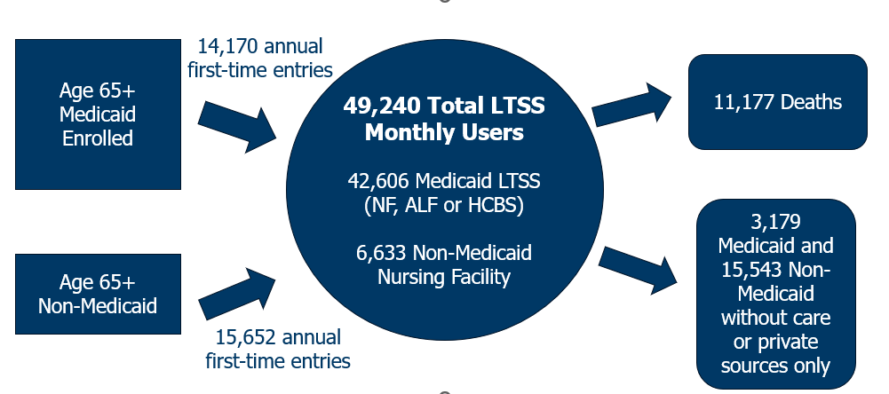
Number of People Entering and Exiting the LTSS System in 2022-2023

Slide 9
Average Number of Monthly LTSS Users by Type in 2022

Slide 10
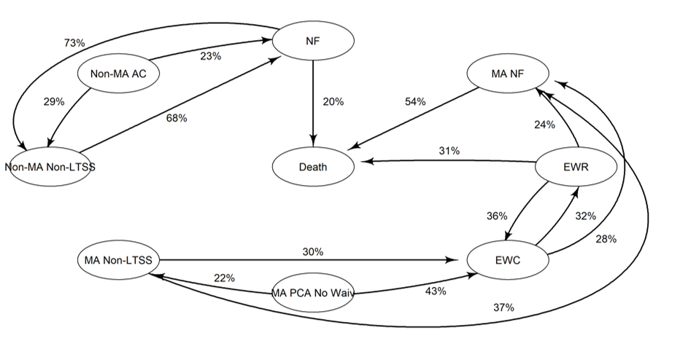
Percentage of Transitions Between LTSS Settings and Programs After First Entering LTSS (Top 20)
MA = Medicaid
Non-MA = Private sources of support
Non-LTSS = No longer using care
NF = Nursing Facility
EWR = Elderly Waiver Assisted Living
EWC = Elderly Waiver In-home and Community Care
PCA = Personal Care Assistant
AC = Alternative Care
Death

Slide 11
COVID-19 and the LTSS System
COVID-19 and the LTSS System

Slide 12
COVID-19 in Minnesota
Minnesota’s outbreak of the COVID-19 pandemic
Outbreak began in March 2020
Deaths peaked in winter of 2020-2021
Deaths subsided through the rest of 2021
Periods for purposes of the study
Pre-COVID – 2016 thru 2019 (2018-2019 serves as the baseline for future projections)
COVID – 2020 thru 2021
Post-COVID – 2022 thru mid-2023
Age 85+ and nursing home users
Experienced the highest all cause mortality across all three periods
Mortality peaked during COVID period

Slide 13
Monthly Deaths by Type of LTSS

Slide 14
Monthly Deaths by Age

Slide 15
Annual LTSS Use by Period
Annual LTSS Use by Period

Slide 16
Patterns in LTSS Use by Period
Number of Nursing Facility residents trended steadily downward from 2016-2019, accelerated downward during the COVID period in 2020-2021, and plateaued at a lower level in 2022-2023
Number of Assisted Living Facility residents trended upward 2016-2019, dipped during the COVID period in 2021, then resumed an upward trend in 2022-2023
Number of HCBS participants trended steadily upward from 2016-2023 without interruption during the COVID period

Slide 17
Average Monthly Users by Year
Pre-COVID
COVID
Post-COVID

Slide 18
Average Monthly Users by LTSS Type
Medicaid Nursing Facility Residents
Non-Medicaid Nursing Facility Residents
Assisted Living Facility Residents
Home and Community Based Services Participants

Slide 19
Trends Pre-COVID, COVID, and Post-COVID
LTSS Type or Age | Pre-COVID | COVID | Post-COVID
MA Nursing Facility (NF) Use | ↓ | ↓ | →
Non-MA Nursing Facility (NF) Use | ↓ | ↓ | →
Assisted Living Facility (ALF) Use | ↑ | ↓ | ↑
Home and Community Based Service (HCBS) Use | ↑ | ↑ | ↑
Age 85+ | NF ↓ ALF → HCBS ↑ | NF ↓ ALF ↓ HCBS ↑ | NF ↓ ALF → HCBS ↑

Slide 20
Patterns of LTSS Use by Age Group
Much of the decline in Nursing Facility use appeared to be due to a decline in people age 85 and older.
The number of Nursing Facility residents age 85+ trended downward 2016-2019, dipped during the COVID period in 2020-2021, and then continued downward in 2022-2023.
The number of Nursing Facility residents age 65-74 and age 75-84 generally held steady across periods, with a small dip in 2020-2021.
Most of the growth in Assisted Living Facility residents and HCBS participants was among people under the age of 85.
The number of Assisted Living Facility residents age 85 and older trended gradually downward, while those age 65-74 and 75-84 trended steadily upward across periods.
The number of HCBS participants age 85 and older generally held steady across periods while those 65-74 and 75-84 trended steadily upward.

Slide 21
All LTSS Users by Age

Slide 22
Users by LTSS Type (Monthly Use Averaged Over a Quarter)
Medicaid Nursing Facility Residents
Non-Medicaid Nursing Facility Residents
Assisted Living Facility Residents
Home and Community Based Services Participants

Slide 23
Growth in the Older Population across Periods (2016-2023)
The Minnesota population aged 65 and older grew steadily from 2016-2019, dipped during the COVID pandemic, and then resumed a steady growth in 2022-2023.
Because of very high COVID-19 death rates, the population age 85 experienced a large decline in 2021.
In the same year, the population age 75-84 had only a modest decline, and age 65-74 had very little decline.
By 2023, Minnesota had over 1 Million people aged 65 or older which was nearly 18% of the total population.

Slide 24
Minnesota Population by Year
Total Minnesota Population Age 65 and Older by Year
Minnesota Population Age 65-74 by Year
Minnesota Population Age 75-84 by Year
Minnesota Population Age 85 and Older by Year

Slide 25
Rates of Monthly LTSS Use when Considering Population Growth from 2016-2022
The overall rate of Nursing Facility use declined by 59% for Medicaid residents and 52% for non-Medicaid residents. The rate trended steadily downward for all three age groups.
The overall rate of LTSS use by Assisted Living residents declined 10%. However, the decline was mainly among people aged 85 and older; the rate increased by small percentages for residents aged 65-74 and 75-84.
The overall rate of LTSS use by participants in home and community-based service programs declined by 8%. The rate among participants aged 85 and older increased by a small percentage, while the rate among participants aged 65-74 and 75-84 declined by a small percentage.

Slide 26
Change in LTSS Rates Between 2016 and 2022
LTSS Setting | Age | 2016 | 2022 | % Change
MA Nursing Facility | 65-74 | 4.93 | 3.78 | -31%
 | 75-84 | 15.98 | 11.65 | -37%
 | 85+ | 60.57 | 39.23 | -54%
Total |  | 16.12 | 10.16 | -59%
Non-MA Nursing Facility | 65-74 | 2.0 | 1.6 | -29%
 | 75-84 | 9.6 | 7.0 | -38%
 | 85+ | 43.3 | 32.0 | -35%
Total |  | 10.2 | 6.7 | -52%
Assisted Living Facility | 65-74 | 3.2 | 3.3 | 5%
 | 75-84 | 12.1 | 12.3 | 2%
 | 85+ | 37.7 | 35.7 | -5%
Total |  | 10.7 | 9.7 | -10%
Home and Community Based Services | 65-74 | 17.6 | 16.2 | -9%
 | 75-84 | 32.2 | 30.2 | -7%
 | 85+ | 34.9 | 36.2 | 3%
Total |  | 24.3 | 22.6 | -8%

Slide 27
Monthly LTSS Users per 1000 Older Population by Age

Slide 28
Users per 1000 Older Population by Age and LTSS Setting
Medicaid Nursing Facility Residents
Non-Medicaid Nursing Facility Residents
Assisted Living Residents
Home and Community Based Services Participants

Slide 29
Medicaid LTSS Service Use and Payments in Pre-COVID and Post-COVID Periods
Medicaid LTSS Service Use and Payments in Pre-COVID and Post-COVID Periods

Slide 30
Changes in Medicaid LTSS Service Use and Payments between Pre-COVID and Post-COVID Periods
The annual number of LTSS users decreased by 6% from 52,325 to 49,251
The steepest decline in LTSS use was in the number of Medicaid Nursing Facility residents that fell by 22% from 19,703 to 15,284
Average monthly Medicaid LTSS payments per user increased by 28% from $2,048 to $2,618
Average annual Medicaid LTSS payments per user increased by 19% from $34,926 to $41,440
The steepest increases in annual payments were for Nursing Facility residents which rose by 32% from $48,799 to $64,199 and Assisted Living Facility residents which rose by 31% from $21,589 to $28,343

Slide 31
Number of People Using LTSS Annually

Slide 32
Average Monthly Medicaid Payments per Person

Slide 33
Average Annual Medicaid Payments per Person

Slide 34
Projection Methods and Assumptions
LTSS Use and Payment Projections

Slide 35
Approach
Straight line projections 2025 thru 2035
Rates of annual LTSS use and Medicaid payments
Nursing Facility
Assisted Living Facilities (ALF)
LTSS In-Home and Community Services (EW non-residential, PCA, Alternative Care)
Annual projected increase in the Minnesota older population
Separate projections by age group and gender

Slide 36
Two Scenarios
Post-COVID Projections
Begin with Post-COVID projections
Continue projections through 2035
Blended Pre-COVID and Post-COVID Projections
Begin with the post-COVID scenario at 100% in 2024
Blend in pre-COVID scenario increasing at 9% per year
End with pre-COVID scenario at 100% in 2035

Slide 37
Assumptions
Both scenarios assume the same growth rates in per person LTSS costs
Start with the same annual LTSS costs in 2025
Conservative growth rates - per person costs grow at 2.5% per year from 2025-2035
Both scenario assume the same annual growth in the general population
Population projections are by age and gender
Source – State Demographic Projections
Difference is in the rates of LTSS use between the Post-COVID scenario and return to Pre-COVID scenario (Blended)

Slide 38
Projections
Straight line projections based on age and sex specific -
Rates of annual LTSS use and Medicaid payments
Annual projected increase in the Minnesota older population
Two Scenarios
Post-COVID - Continue Post-COVID rates from 2025 thru 2035
Blended - Begin with post-COVID rates in 2025, then steady return to pre-COVID by 2035

Slide 39
Projected Total Minnesota Older Population (Age 65 and Older)

Slide 40
Projected Minnesota Older Population by Age

Slide 41
Projected Users by Age
Projected LTSS Users: All
Projected LTSS Users: Age 65-74
Projected LTSS Users: Age 75-84
Projected LTSS Users: Age 85+

Slide 42
Change in LTSS Users by Age and Scenario (2025-2035)

Slide 43
Projected Users by LTSS Setting
Projected LTSS Users: Nursing Facility
Projected LTSS Users: Assisted Living Facility
Projected LTSS Users: In Home Care
Projected LTSS Users: PCA

Slide 44
Change in LTSS Users by LTSS Type and Scenario (2025-2035)

Slide 45
Projected Medicaid Costs for All Users ($ Millions)

Slide 46
Projected Medicaid Costs by Care Setting ($ Millions)

Slide 47
LTSS Use and Payment Projections with Discussion and Next Steps
Cost Projections and Medicaid Spending

Slide 48
Projected Medicaid LTSS Cost Scenarios & Hypothetical Spending Growth
We compared projected Medicaid LTSS cost and utilization scenarios to a hypothetical scenario where Medicaid LTSS funding grows at a constant rate of 2.5% from 2025-2035.
Funding starts at the same level as LTSS costs in 2025 but then grows at a constant 2.5% per year.
Projected LTSS costs grow at 2.5% and 5.0%. These growth rates reflect both future cost inflation and future use of LTSS which is driven by increases in the older population.
This comparison highlights the gap between LTSS costs and spending if spending fails to account the future needs of a growing older population.

Slide 49
Findings - Projected Medicaid LTSS Cost Scenarios & Hypothetical Spending Growth
In the early years (2026-2027) the gap between hypothetical Medicaid funding and projected LTSS cost scenarios is relatively narrow.
By 2030 there is a substantial gap that escalates by 2035.
The gap between cost growth and spending is much greater if LTSS costs grow at 5% rather than at 2.5%.
The gap is greatest for nursing facility costs in the scenario where LTSS utilization returns to pre-COVID levels.
There is still a substantial gap under the scenario where LTSS utilization returns to pre-COVID levels

Slide 50
Projected Medicaid LTSS Cost Scenarios & Hypothetical Spending Growth 2.5% LTSS Cost Inflation & 2.5% Medicaid Spending Growth

Slide 51
Projected Medicaid LTSS Cost Scenarios & Hypothetical Spending Growth 2.5% LTSS Cost Inflation & 2.5% Medicaid Spending Growth

Slide 52
Projected Medicaid LTSS Cost Scenarios & Hypothetical Spending Growth 5.0% LTSS Cost Inflation & 2.5% Medicaid Spending Growth

Slide 53
Projected Medicaid LTSS Cost Scenarios & Hypothetical Spending Growth 5.0% LTSS Cost Inflation & 2.5% Medicaid Spending Growth

Slide 54
LTSS Use and Payment Projections with Discussion and Next Steps
Microsimulation

Slide 55
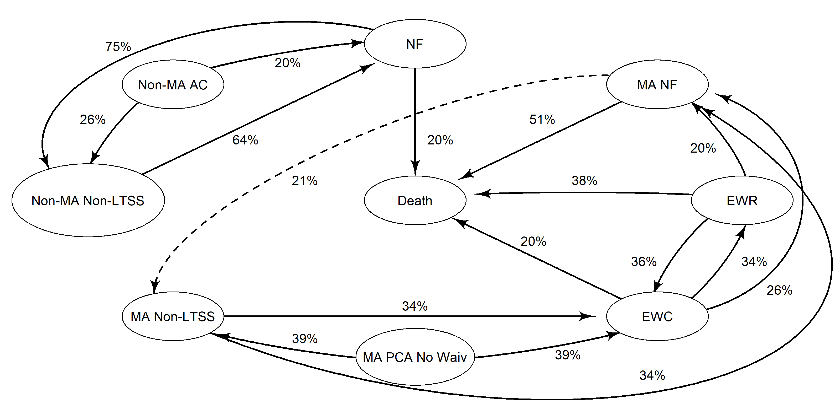
Microsimulation
LTSS use divided into Sub-Groups
How often moving between sub-groups (observed rates pictured)
Months spent in each sub-group
Can simulate individual level trajectories based on observed data
Can test “what if” scenarios by changing inputs to simulation and comparing results

Slide 56
Microsimulation
Two Scenarios: Changes in population level usage rates of LTSS and an increase in AC utilization rates
Assumptions about Minnesota population growth by age group and gender taken from Minnesota State Demographic Center
Assumptions about growth in costs to Medicaid based on DHS Forecast in near term and smoothed out to 2.5% or 5% in the longer term

Slide 57
Microsimulation
Usage Rate Scenario: What is the impact of changes in rates of LTSS usage at the population level?
What if rates remain at the observed post-COVID level?
What if LTSS use returns to pre-COVID patterns?
What if LTSS use continues to substitute HCBS and assisted living for nursing home use?

Slide 58
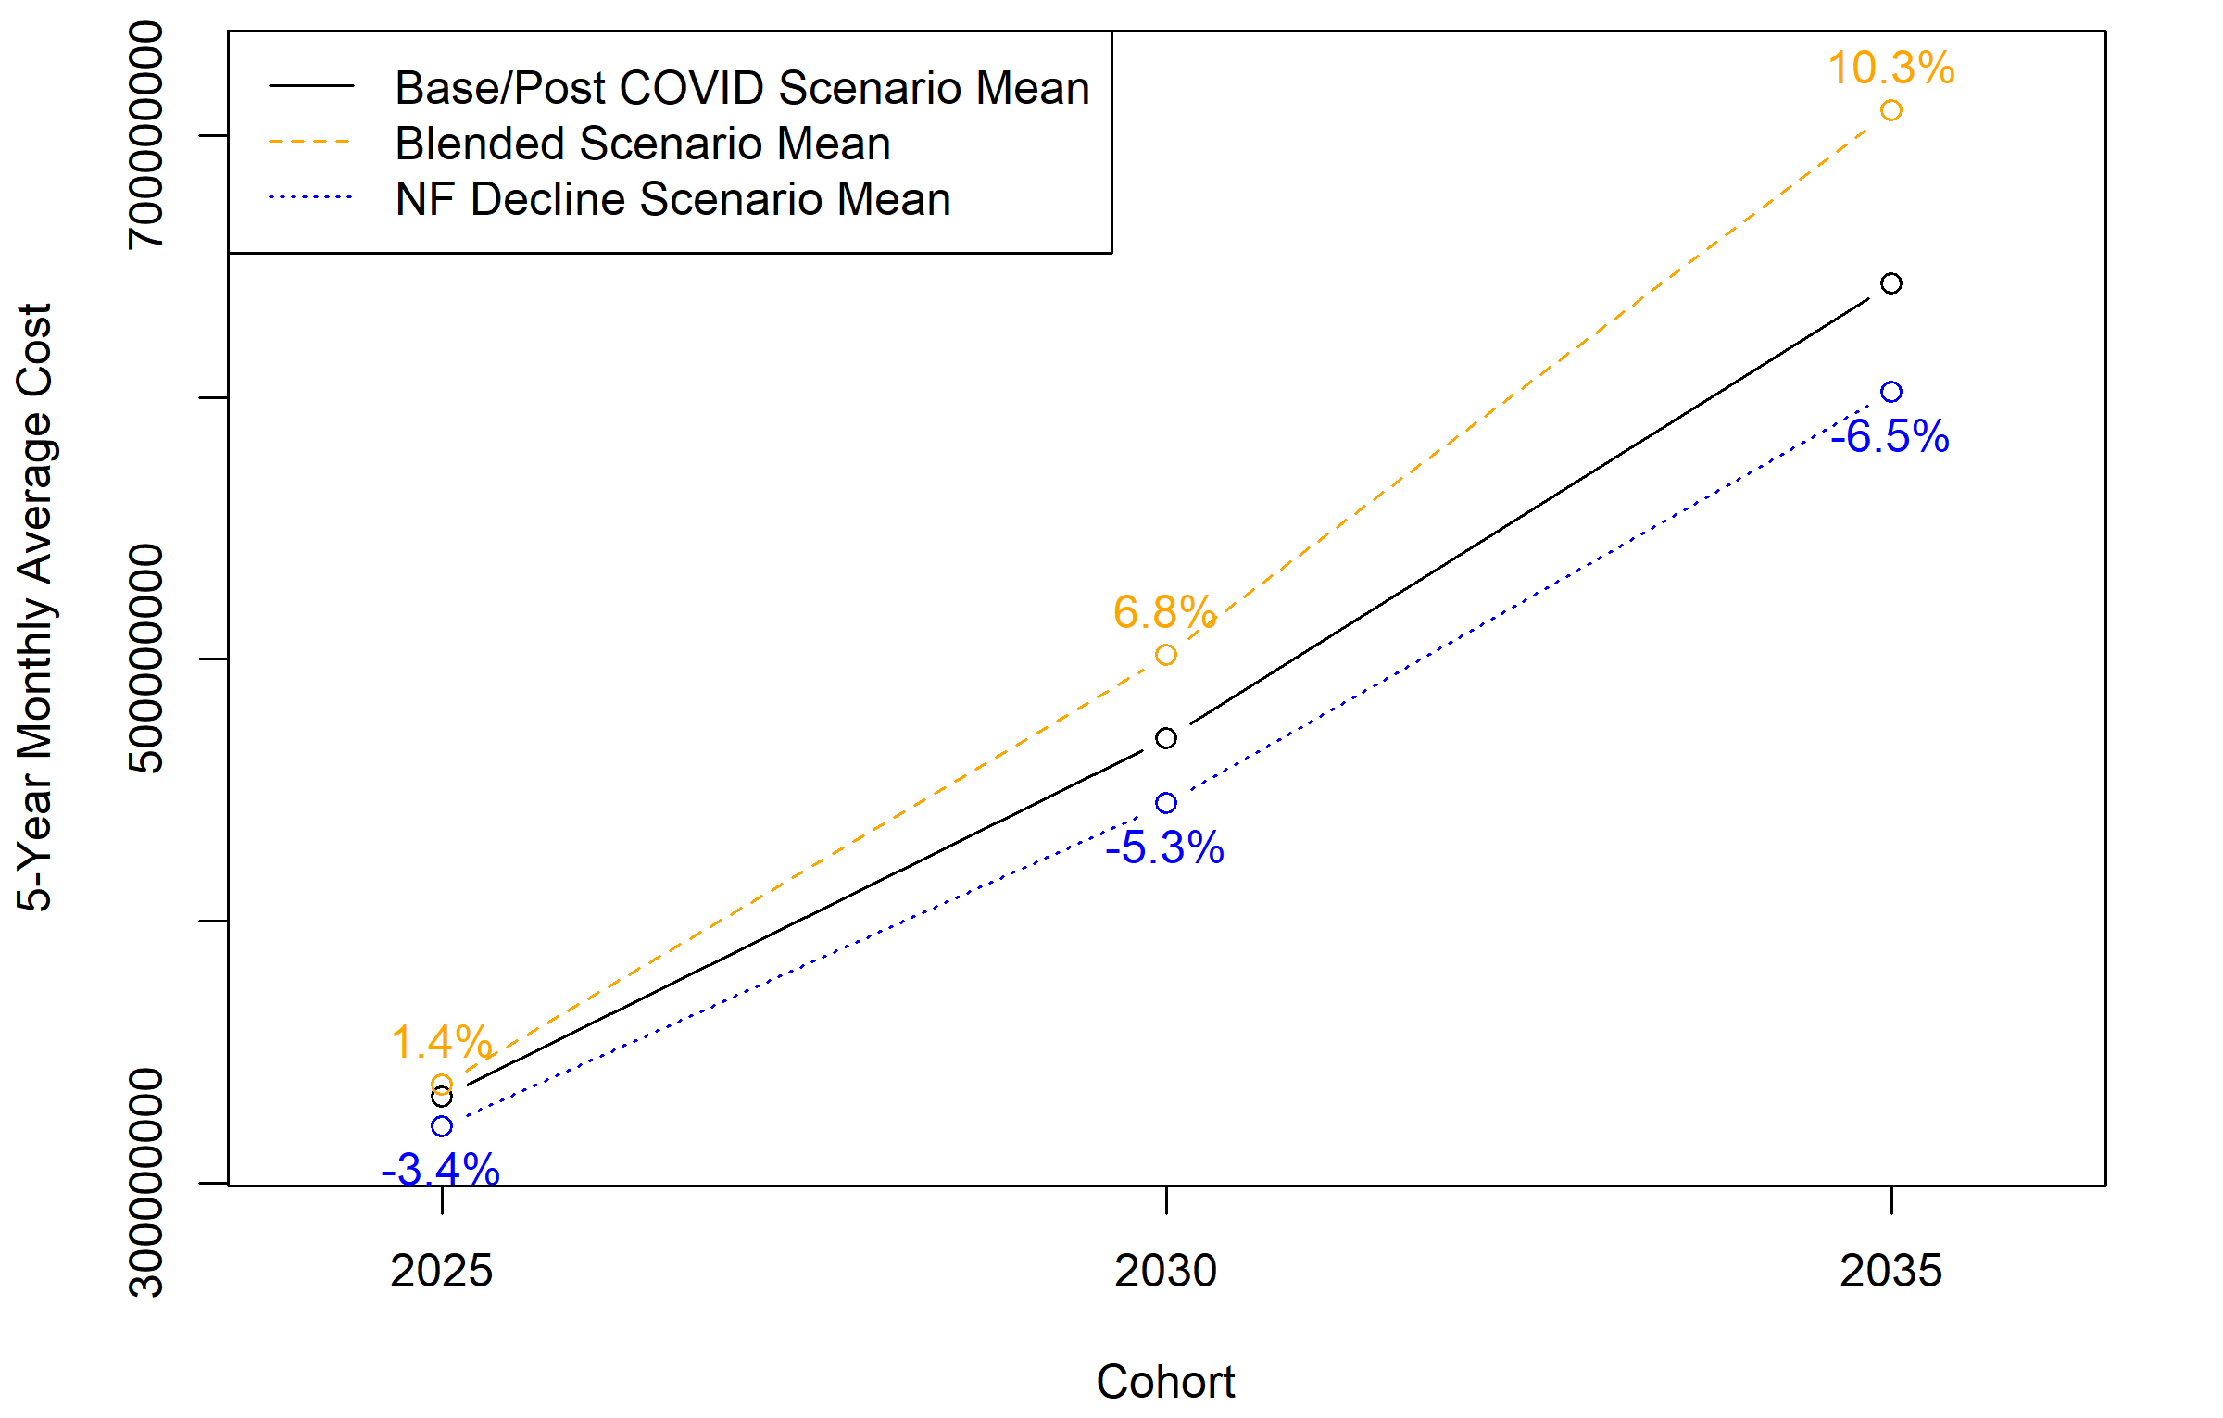
Microsimulation
Solid black line serves as the baseline, rates remaining at currently observed levels.
Return to pre-COVID rates increases estimated costs to Medicaid by 1.4% in 2025-2029 growing to 10.3% in 2035-2039 relative to base case.
Continued substitution of HCBS and assisted living reduces estimated costs to Medicaid by 3.4% in 2025-2029 and by 6.5% in 2035-2039.

Slide 59
Microsimulation
AC Expansion Scenario: Expanding the number of users of the Alternative Care program may help address some of the long-term care planning shortfall for middle income households. What is the impact of expanding AC?
What is the impact on the number of enrollees in AC?
What is the impact on potential private pay nursing home cost savings?
What is the impact on costs to Medicaid?

Slide 60
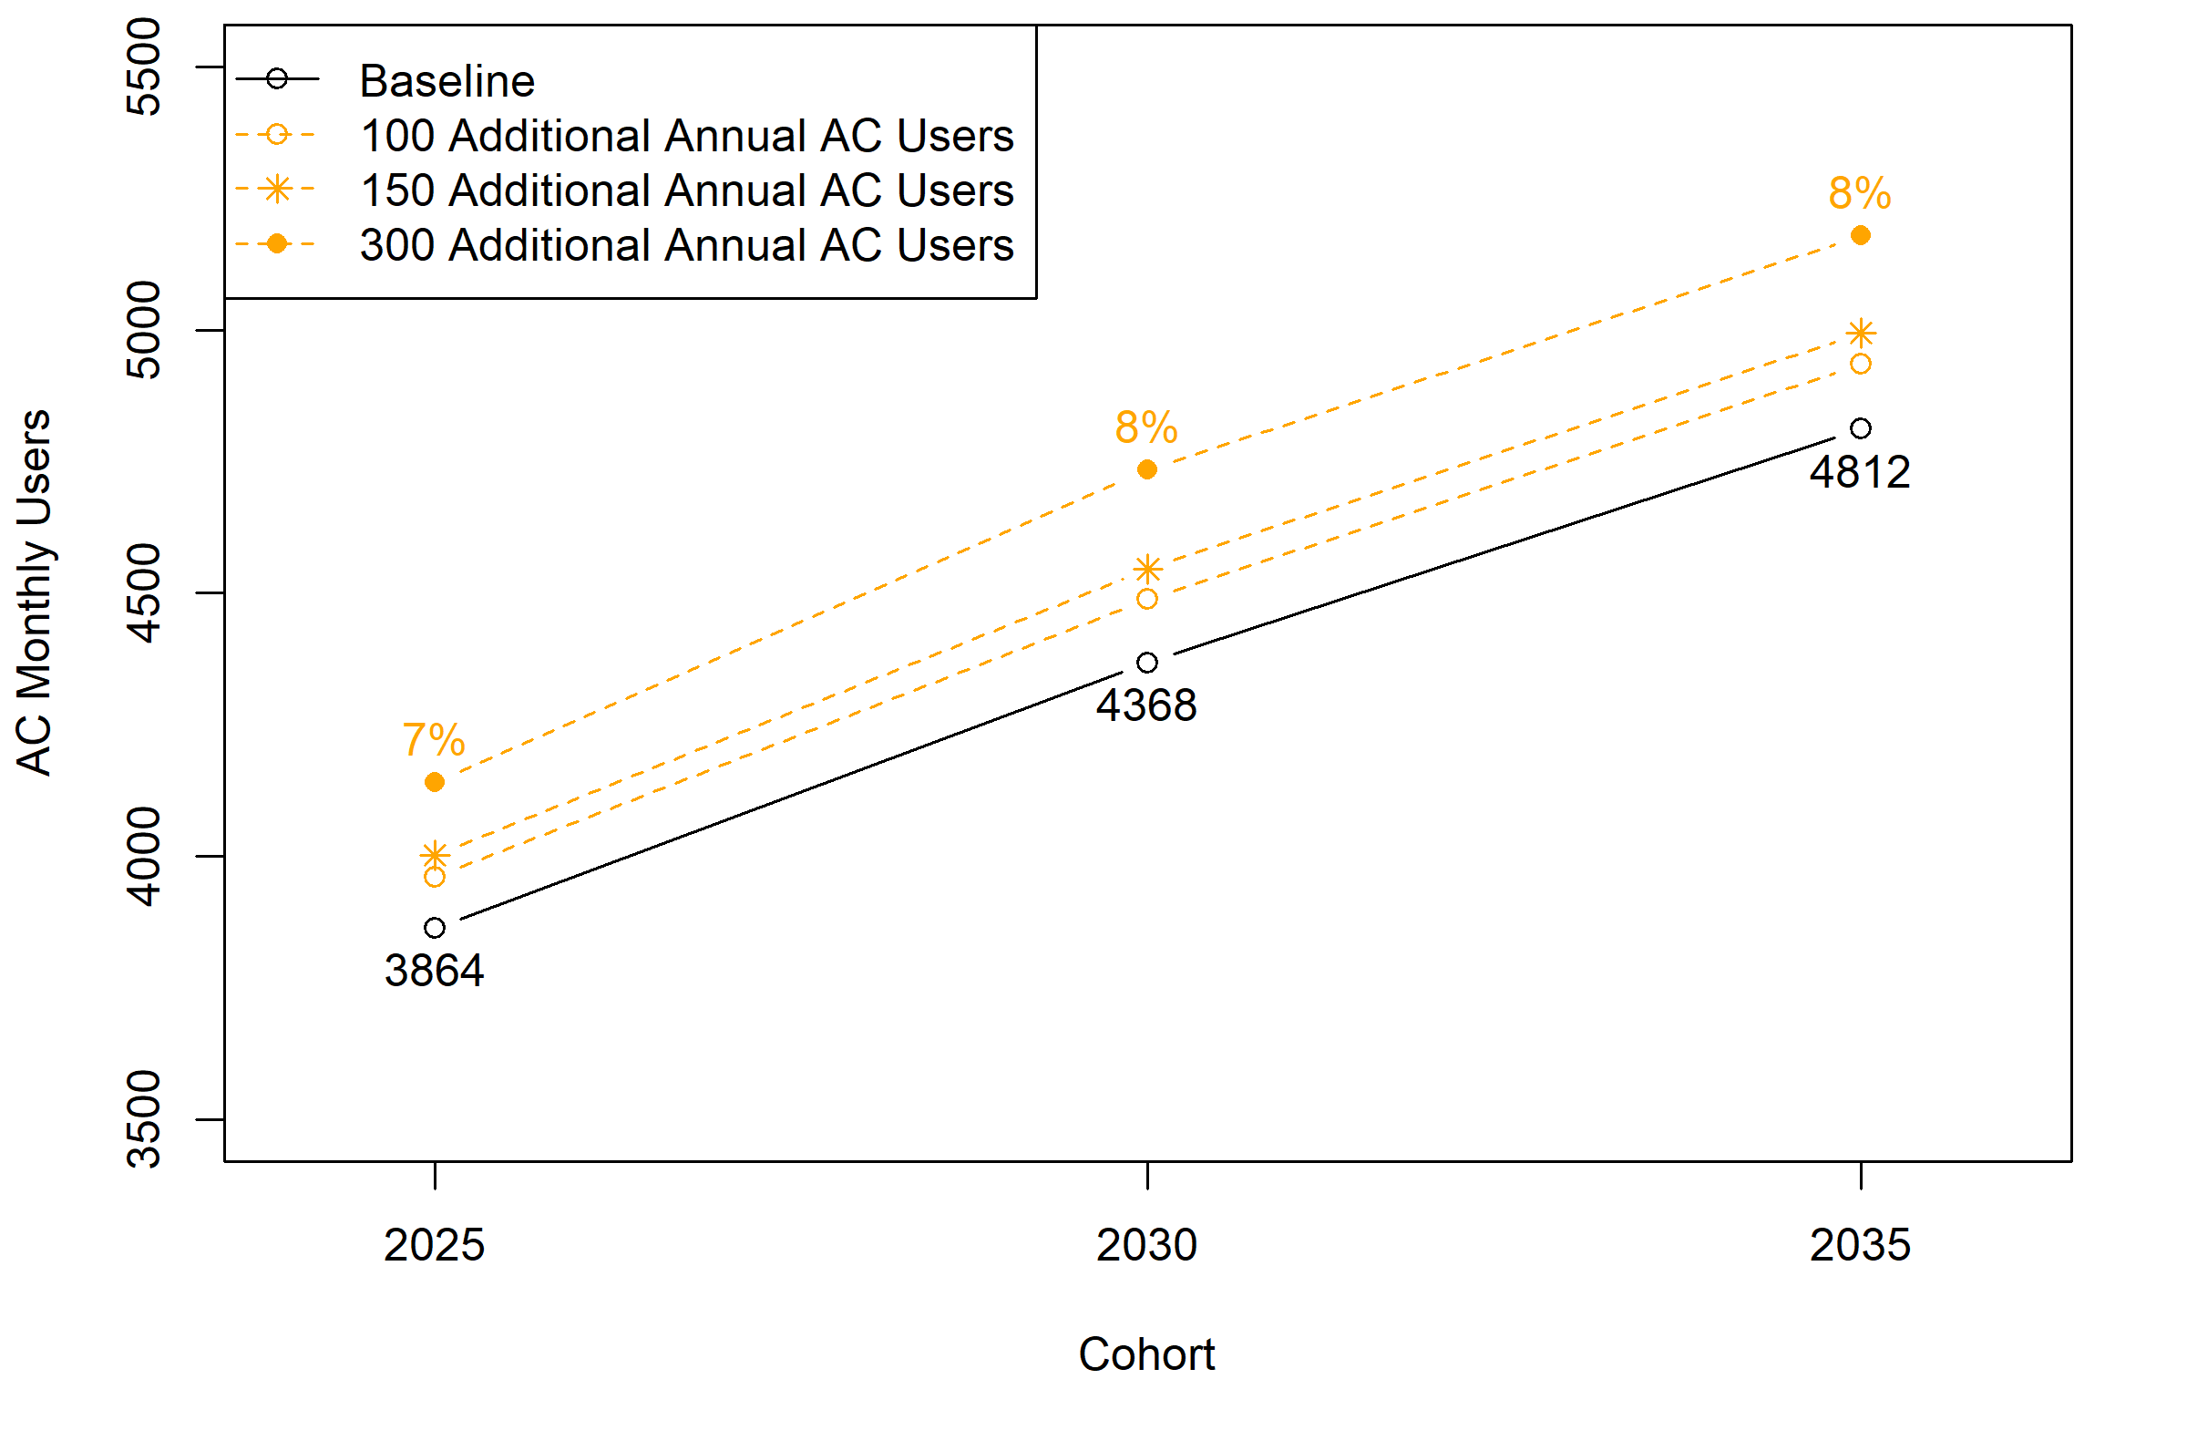
Microsimulation
Scenarios were run assuming 100, 150, and 300 additional AC users per year (beyond projected trends)
This increased AC enrollment by 2.5% - 8%

Slide 61
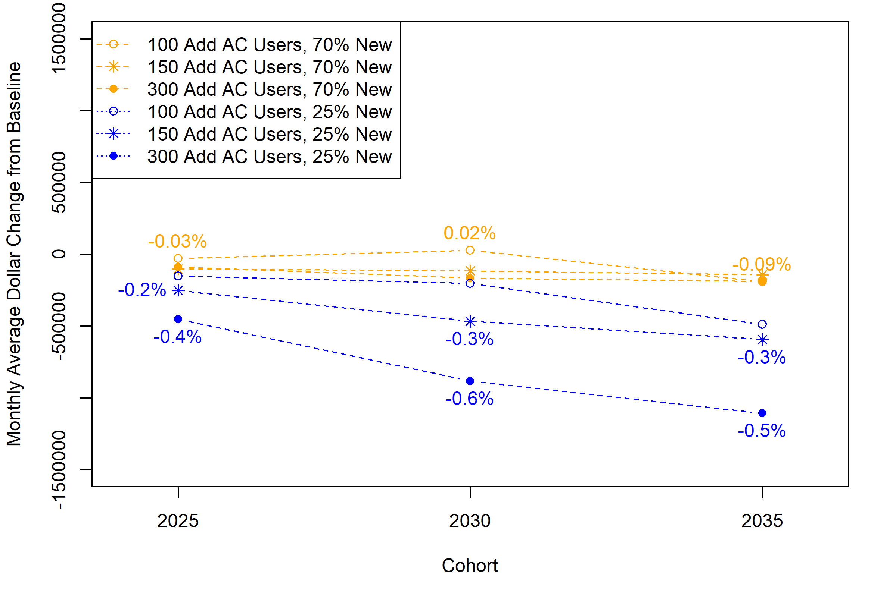
Microsimulation
Scenarios were run testing different LTSS sub-groups as the sources of the new AC participants
Reduction in privately paid nursing home costs were maximized when drawing more AC enrollees from NH residents and less from privately paid HCBS (0.4% -0.6% reduction)

Slide 62
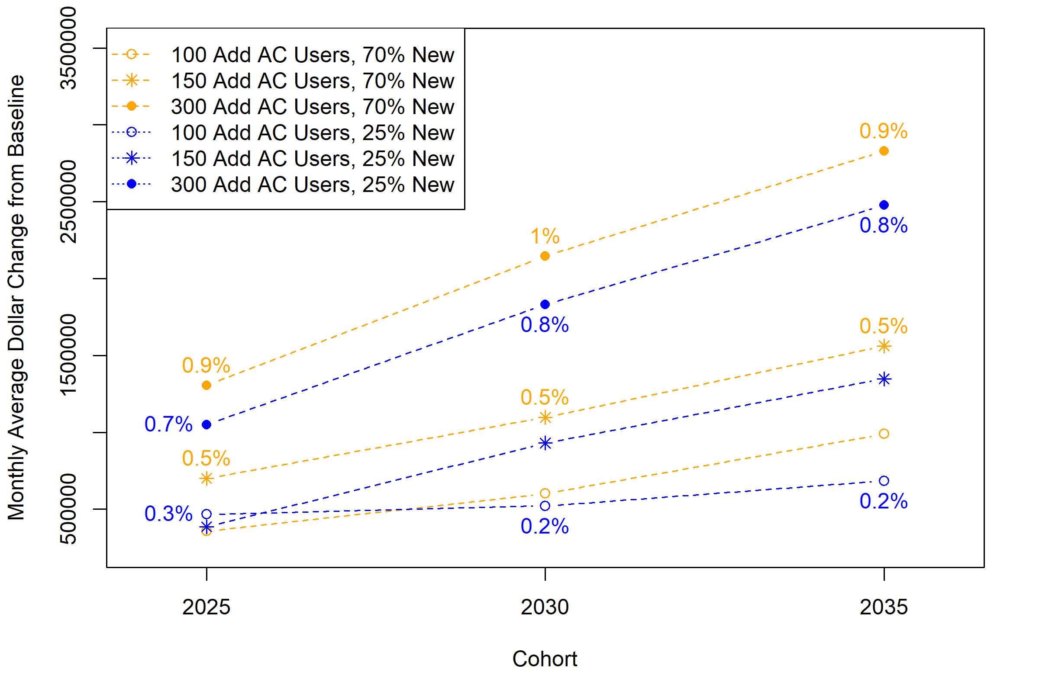
Microsimulation
Expanding AC generally increased the estimated costs to Medicaid
0.2% increase when adding 100 annual AC participants, only 25% from privately paid HCBS users
0.9% increase when adding 300 annual users of which 70% were privately paid HCBS users

Slide 63
LTSS Use and Payment Projections with Discussion and Next Steps
Discussion

Slide 64
Why COVID-Related Declines in Nursing Facility Use?
COVID accelerated an already downward trend in NF occupancy.
NF residents experienced high COVID-related mortality.
Fewer people entered NFs and those who did left more quickly.
Other care settings, such as assisted living facilities or home and community-based services, became an alternative to the nursing facility.

Slide 65
Future Use of Nursing Facility and Other LTSS Settings
In the short-term – there could be excess NF capacity, falling occupancy, and facility closures, particularly in rural areas
In the long-term – steadily growing NF demand with projected increases in the older population
Continued trend toward more short-term, post-acute NF stays.
Shift from NF use to assisted living facilities or in-home care, especially for people with cognitive needs.
Potential for Medicaid savings with a shift away from NFs.

Slide 66
External Factors Affecting LTSS Projections
LTSS cost growth will put pressure on Medicaid budgets and privately paying LTSS users.
Future labor force shortage of nurses, aides, home care workers.
Decline in informal caregiving by family and other informal caregivers.
The increased racial and ethnic diversity of the older population could change patterns of LTSS use and raise issues of equity in access to and quality of care

Slide 67
LTSS Use and Payment Projections with Discussion and Next Steps
Discussion and Next Steps

Slide 68
Why COVID-Related Declines in Nursing Facility Use?
COVID-19 accelerated a steady downward trend in Nursing Facility use that began during the pre-COVID period.
COVID-related mortality that was most severe in Nursing Facilities
Shorter Nursing Facility stays – leaving the Nursing Facility to reduce COVID exposure and isolation and quarantining of residents
Reluctance to enter Nursing Facilities in the first place – exposure to COVID and high mortality rates
Quarantining and other restrictions on Nursing Facility admissions
Substitution of other care settings for Nursing Facilities – assisted living facilities and home and community-based services

Slide 69
Future Use of Nursing Facility and Other LTSS Settings
Rate of Nursing Facility use is declining while the heaviest users of Nursing Facilities (age 85+) are increasing
In the short run – there will be excess Nursing Facility capacity, falling occupancy, and facility closures, particularly in rural areas
In long run – steadily growing Nursing Facility demand as the population ages
Shift toward post-acute Nursing Facility care and away from longer NF stays
More people, especially with cognitive needs, enter assisted living facilities or receive care at home instead of entering a Nursing Facility
Potential Medicaid savings with a shift away from Nursing Facilities toward ALF and HCBS which have costs substantially below NFs

Slide 70
External Factors Affecting LTSS Projections
LTSS cost growth leading to constraints on Medicaid budgets and financial pressures on the middle-income population paying privately for LTSS
Changes in the financial resources or rates of disability among succeeding older generations
Labor force challenges – shortage of nurses, aides, home care workers
Potential decline in informal caregiving by family and other informal caregivers
Increased racial and ethnic diversity, particularly with HCBS use

Slide 71
Next Steps
Finalize Interim Report
Revise and refine LTSS Simulations
Test alternative scenarios

